Slide 1
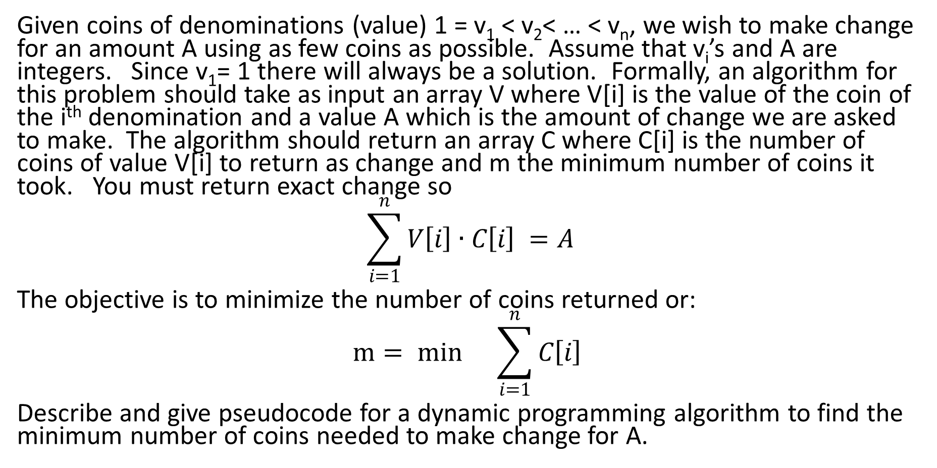
Coin Change
Given coins of denominations (value) 1 = v₁ < v₂< … < v_{n}, we wish to make change for an amount A using as few coins as possible. Assume that v_{i}’s and A are integers. Since v₁= 1 there will always be a solution. Formally, an algorithm for this problem should take as input an array V where V[i] is the value of the coin of the i^{th} denomination and a value A which is the amount of change we are asked to make. The algorithm should return an array C where C[i] is the number of coins of value V[i] to return as change and m the minimum number of coins it took. You must return exact change so
$$\sum_{i=1}^{n}{V\left[i\right]∙C\left[i\right] =A}$$
The objective is to minimize the number of coins returned or:
$$m= min{}\sum_{i=1}^{n}{C\left[i\right] }$$
Describe and give pseudocode for a dynamic programming algorithm to find the minimum number of coins needed to make change for A.

Slide 2
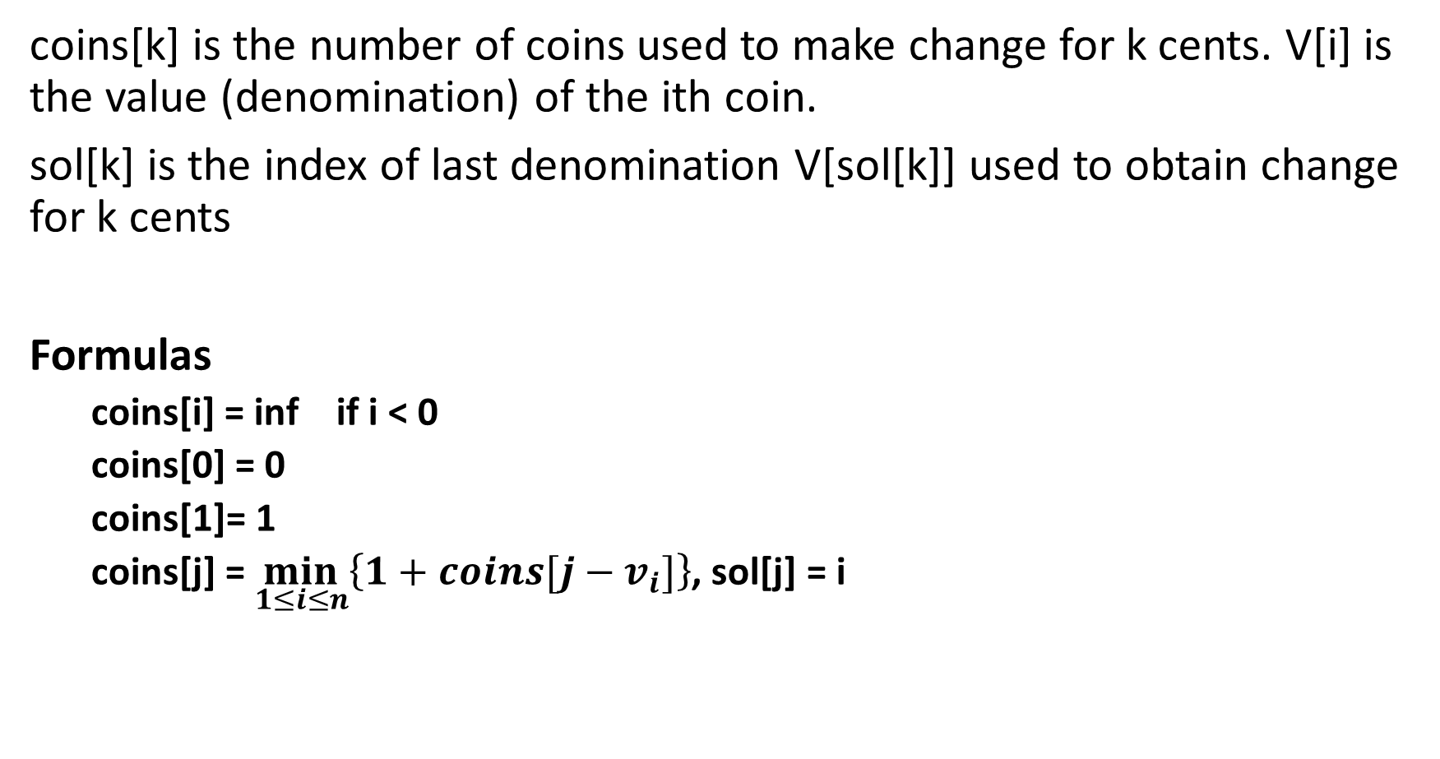
coins[k] is the number of coins used to make change for k cents. V[i] is the value (denomination) of the ith coin.
sol[k] is the index of last denomination V[sol[k]] used to obtain change for k cents
Formulas
coins[i] = inf if i < 0
coins[0] = 0
coins[1]= 1
coins[j] = $\min_{1≤i≤n}\left\{1+coins[j−v_{i}]\right\}$, sol[j] = i

Slide 3
Sample pseudocode
minCoins(A, V[], n)
coins[0]=0; coins[1] = 1
for j = 2 to A do {
min = inf
for i = 1 to n do {
if ( j >= V[i] )
if ( (coins[j-V[i]] + 1) < min )
{
min = coins[j-V[i]] + 1
index = i
}
}
coins[j] = min
sol[j] = index
}
return coins[A], sol[A]

Slide 4
To reconstruct the series of coins used to obtain change for A with minimum number of coins. Call MakeChange(sol, V, A).
MakeChange(sol[], V[], m)
C[] = 0;
while m > 0 {
Print V[sol[m]]
C[sol[m]] = C[sol[m]] + 1
m = m – V[sol[n]]
}
V[i] is the value of the ith coin.
Sol[j] is the index of the last coin to make change for an amount of j
C[i] is the number of times the ith coin is used in the solution.

Slide 5
Theoretical running time
The running time of MakeChange is O(A)
The running time of minCoins is Θ(nA) since the outer loop is j = 2 ..A and inner loop is i = 1 ..n.
Overall Θ(nA)

